Slide 1
Poultry Disease Classification Presentation

Slide 2
Poultry Disease Classification Presentation
Introduction: Revolutionizing Poultry Health
The Impact of Poultry Diseases
Traditional Diagnosis: Methods and Limitations
Deep Learning: A Powerful Tool for Image Analysis
Understanding Transfer Learning: Reusing Knowledge
Advantages of Transfer Learning for Poultry Disease Classification
Model Architectures and Data for Disease Classification
Implementing Transfer Learning: Promising Results
Enhanced Health Management: The Impact
Challenges and Future Outlook

Slide 3
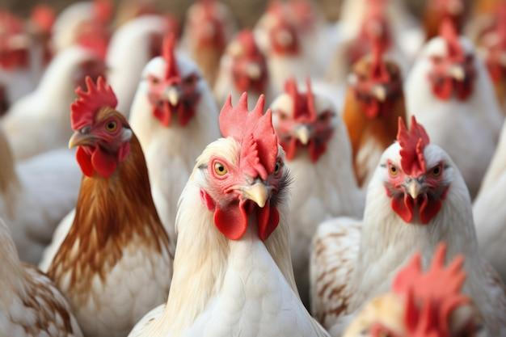
Introduction: Revolutionizing Poultry Health
The global poultry industry faces significant economic losses due to prevalent diseases.
Early and accurate disease detection is crucial for effective health management and preventing widespread outbreaks.
This presentation explores how transfer learning, a powerful deep learning technique, can enhance the classification of poultry diseases.

Slide 4
The Impact of Poultry Diseases
Poultry diseases like Marek's Disease, Infectious Bronchitis, and Salmonella cause severe symptoms including anorexia, respiratory distress, and decreased egg production.
These diseases lead to high mortality rates, reduced productivity, and significant financial burdens for farmers.
Rapid identification is key to containment and treatment.

Slide 5
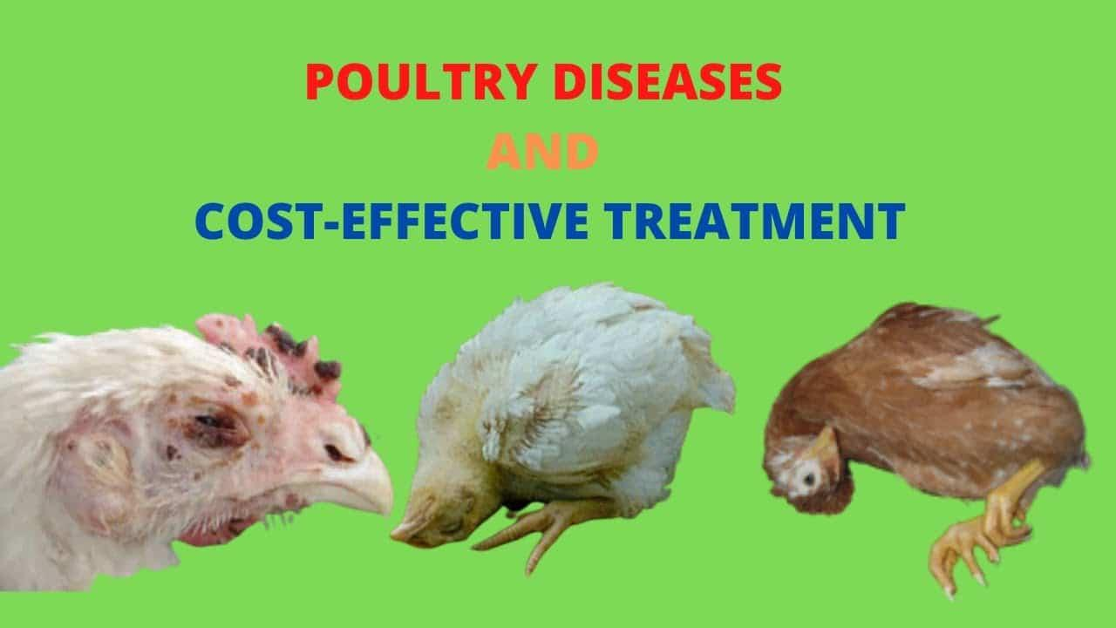
Traditional Diagnosis: Methods and Limitations
Traditional disease diagnosis often relies on visual inspection, clinical signs, and laboratory tests.
These methods can be time-consuming, labor-intensive, and may lack the sensitivity for early-stage detection.
Delays in diagnosis can lead to faster disease spread and less effective interventions.

Slide 6
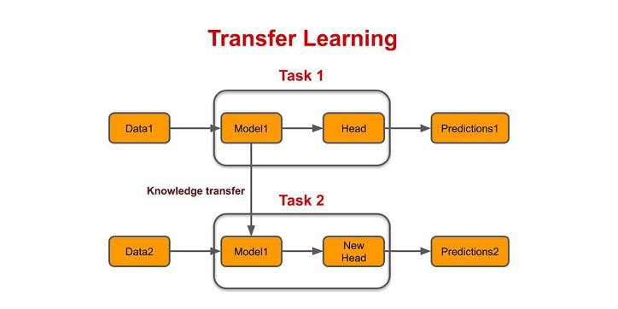
Deep Learning: A Powerful Tool for Image Analysis
Deep learning, a subset of machine learning, excels in identifying patterns in complex data, especially images.
Convolutional Neural Networks (CNNs) are particularly effective for image recognition tasks by learning hierarchical features from raw pixel data.
This capability makes CNNs ideal for analyzing visual symptoms of diseases.

Slide 7
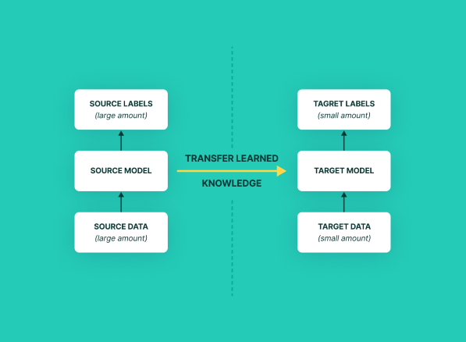
Understanding Transfer Learning: Reusing Knowledge
Transfer learning is a machine learning technique where a model trained on one task is repurposed for a second, related task.
Instead of training a model from scratch, pre-trained models (e.g., on large image datasets like ImageNet) are used as a starting point.
This approach leverages the learned features, saving significant computational resources and time.

Slide 8
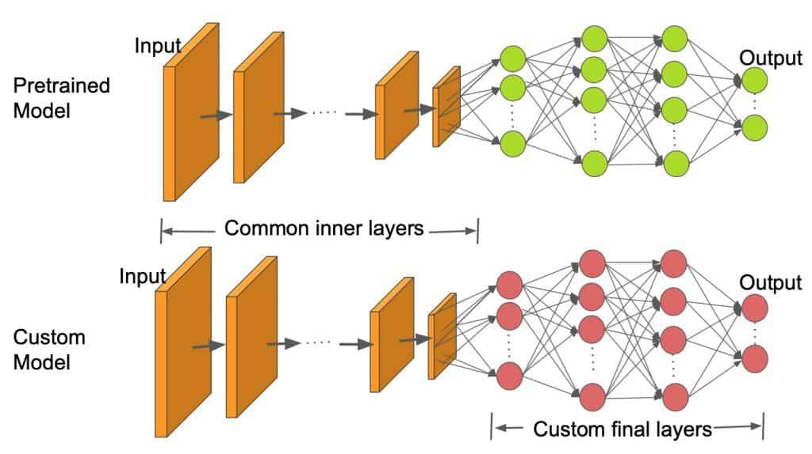
Advantages of Transfer Learning for Poultry Disease Classification
Reduces the need for massive, labeled poultry disease datasets, which are often scarce.
Significantly decreases training time and computational costs compared to training deep CNNs from scratch.
Achieves higher accuracy, especially when dealing with limited specific disease images.

Slide 9
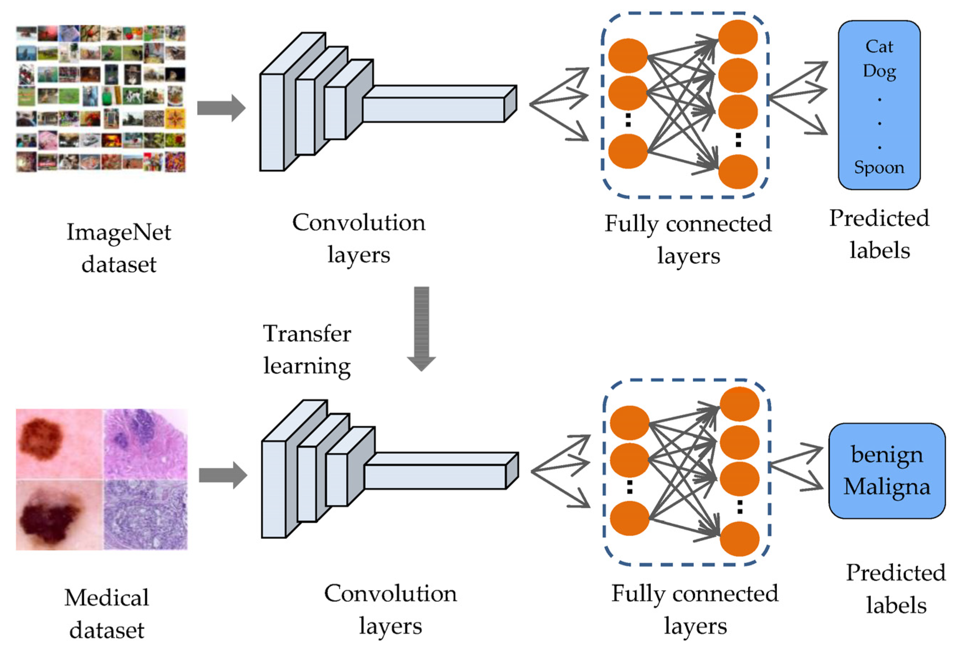
Model Architectures and Data for Disease Classification
Popular pre-trained CNN architectures used include ResNet, Inception, VGG, and EfficientNet.
These models are fine-tuned by replacing or modifying the final classification layers to suit poultry disease categories.
High-quality image datasets of poultry (e.g., fecal samples, visual symptoms) are crucial for training and validation, with preprocessing steps like augmentation.

Slide 10
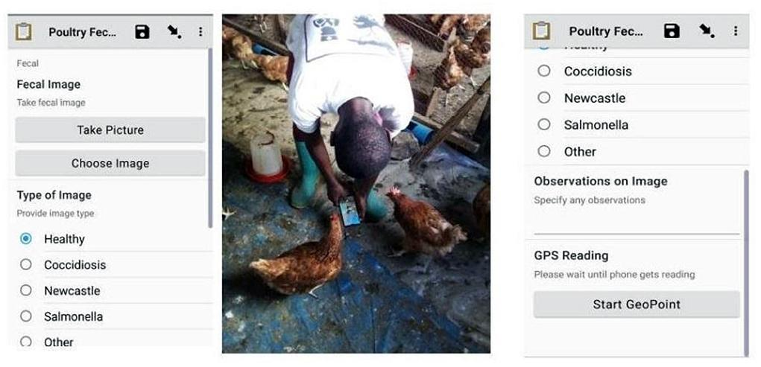
Implementing Transfer Learning: Promising Results
Studies have demonstrated remarkable accuracy, with some models achieving up to 99.75% in classifying common poultry diseases.
Models are often trained on images of affected birds, their droppings, or specific lesions.
The success highlights the potential for automated and accurate disease identification systems.

Slide 11
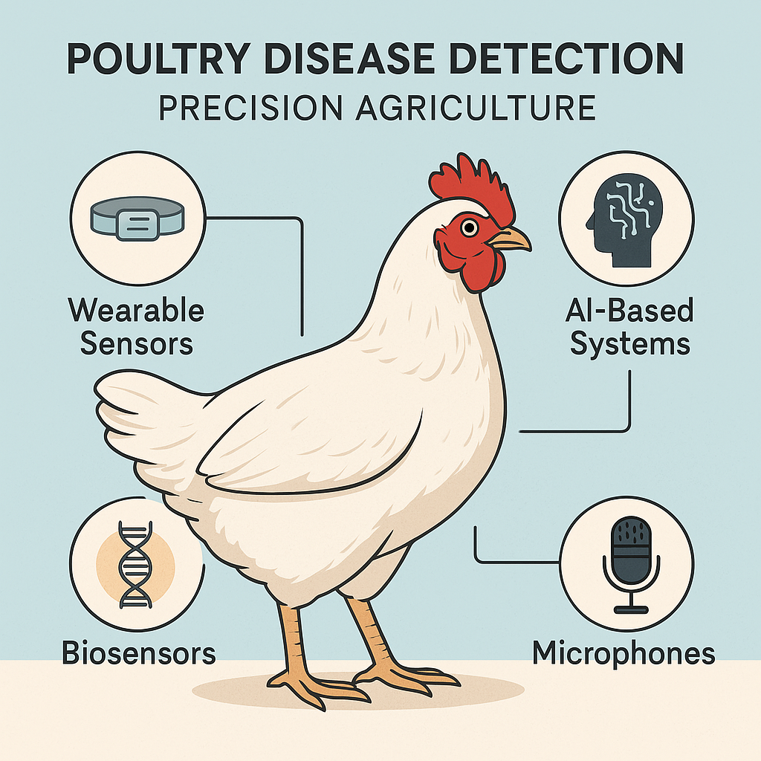
Enhanced Health Management: The Impact
Early and accurate detection facilitates prompt isolation of infected birds, preventing widespread outbreaks.
Allows for targeted and timely treatment, reducing medication costs and improving animal welfare.
Contributes to a more sustainable and economically viable poultry farming industry through proactive health management.

Slide 12
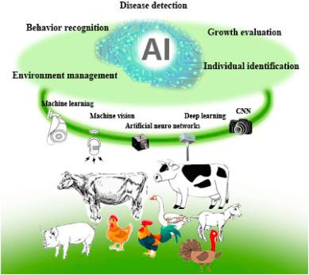
Challenges and Future Outlook
Challenges include the need for diverse and extensive image datasets covering various disease stages and breeds.
Ensuring model robustness against real-world variations (lighting, pose, environmental factors) is crucial.
Future directions involve integrating AI models with IoT devices for real-time, continuous monitoring.

